Slide 1
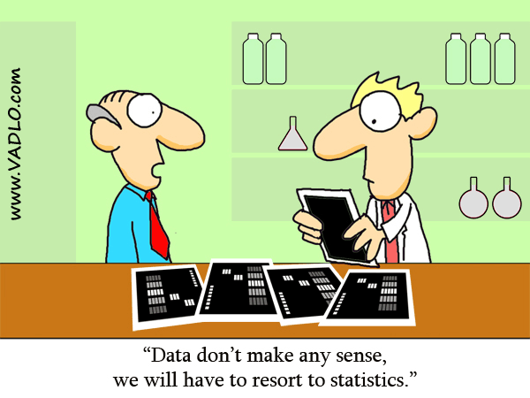
Chapter 0: Why Study Statistics? Chapter 1: An Introduction to Statistics and Statistical Inference
http://vadlo.com/cartoons.php?id=71

Slide 2
0,1: Introduction: Goals
Create your own definition of statistics.
State some applications of Statistics for your field.
State the branches of statistics and briefly describe each one.
Define: Population, sample, variable
Differentiate between probability and statistics.
Be able to solve word problems in statistics.

Slide 3
What is Statistics
Components
Collection
Organization
Analysis
Interpretation

Slide 4
Branches of Statistics
Collection of data
Descriptive Statistics
Graphical and numerical methods used to describe, organize, and summarize data.
Inferential Statistics
Techniques and methods used to analyze a small, specific set of data in order to draw a conclusion about a large, more general collection of data.

Slide 5
Inferential Statistics
Claim
Status Quo
Experiment
Check claim
Likelihood
How likely is the experimental result consistent with the claim?
Conclusion
The outcome is reasonable
The outcome is rare.

Slide 6
Definitions
A population is the entire collection of individuals or objects to be considered or studied.
A sample is a subset of the entire population, a small selection of individuals or objects taken from the entire collection.

Slide 7
Probability vs. Statistics

Slide 8
Solution Trail
Find the keywords.
Correctly translate these words in statistics.
Determine the applicable concepts.
Develop a vision, or strategy, for the solution.
Solve the problem.

Slide 9
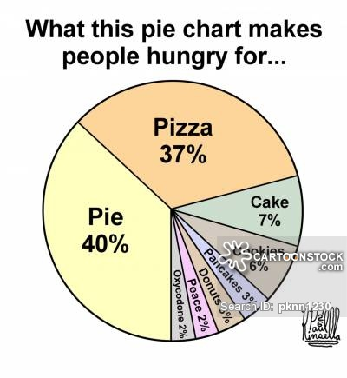
Chapter 2: Tables and Graphs for Summarizing Data
https://www.cartoonstock.com/cartoonview.asp?catref=pknn1230

Slide 10
Types of Data, Graphing: Goals
Section 2.1 Classify variables as
Number of characteristics
Categorical or numerical
Section 2.2 (very brief) Analyze the distribution of categorical variable:
Bar Graphs
Pie Charts
Section 2.3: Skip
Section 2.4 Analyze the distribution of quantitative variable:
Histogram
Identify the shape, center, and spread
Identify and describe any outliers

Slide 11
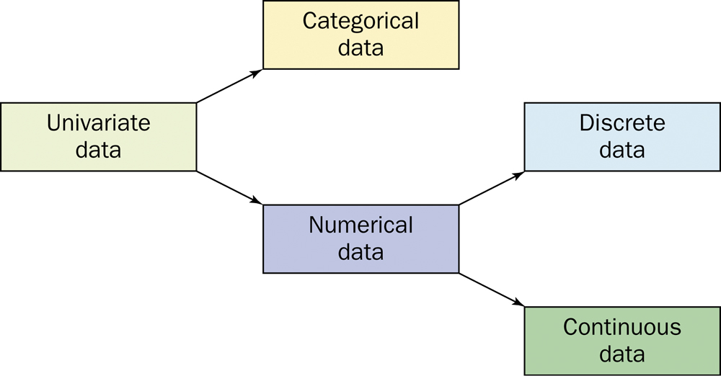
Types of Variables
Number
univariate
bivariate
multivariate
Type
Categorical
Numerical

Slide 12
To better understand a data set, ask:
Who?
What cases do the data describe?
How many cases?
What?
How many variables?
What is the exact definition of each variable?
What is the unit of measurement for each variable?
Why?
What is the purpose of the data?
What questions are being asked?
Are the variables suitable?

Slide 13
Graphs
Categorical Variables
Pie charts
Bar graphs
Quantitative Variables
Histograms

Slide 14
Examining Distributions
In any graph of data, look for the overall pattern and for striking deviations from that pattern.
You can describe the overall pattern by its shape, center, and spread.
For the shape, look at the number of peaks and the symmetry.
An important kind of deviation is an outlier, an individual that falls outside the overall pattern.

Slide 15
Frequency Distribution
The possible values and how often that it takes these values.
The label or class is the category of the data.
The frequency is the count.
$\text{Relative} \text{Frequency}\text{=}\frac{\text{frequency}}{\text{total} \text{count}}$

Slide 16
Categorical Variables - Display
The distribution of a categorical variable lists the categories and gives the count or percent or frequency of individuals who fall into each category.
Pie charts show the distribution of a categorical variable as a “pie” whose slices are sized by the counts or percents for the categories.
Bar graphs represent categories as bars whose heights show the category counts or percents.

Slide 17
Quantitative Variable: Histograms
Histograms show the distribution of a quantitative variable by using bars. Remember to always include the summary table.
Procedure – discrete (small number of values)
Calculate the frequency distribution and/or relative frequency of each x value.
Mark the possible x values on the x-axis.
Above each value, draw a rectangle whose height is the frequency (or relative frequency) of that value.

Slide 18
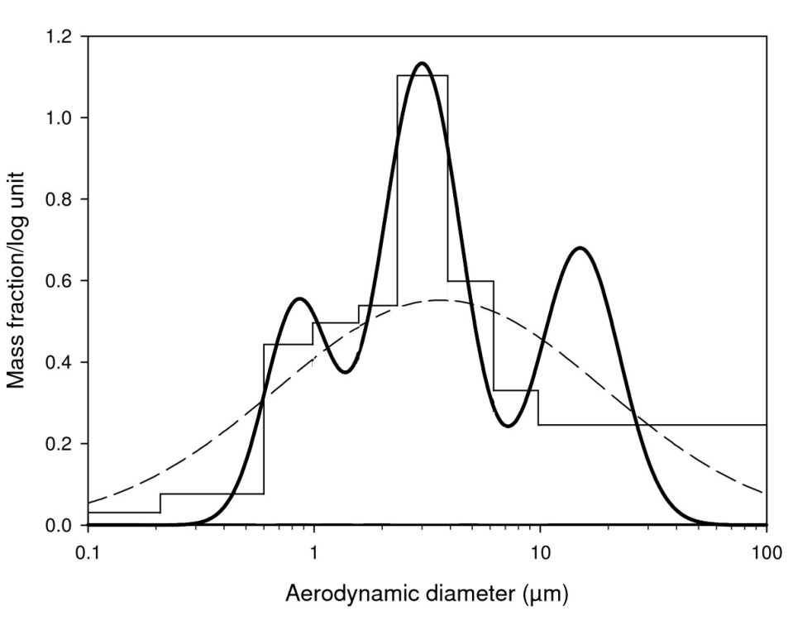
Shapes of Histograms - Number
Symmetric
unimodal
bimodal
multimodal
http://www.particleandfibretoxicology.com/content/6/1/6/figure/F1?highres=y

Slide 19
Shapes of Histograms (cont)
Symmetric
Positively skewed
Negatively skewed

Slide 20
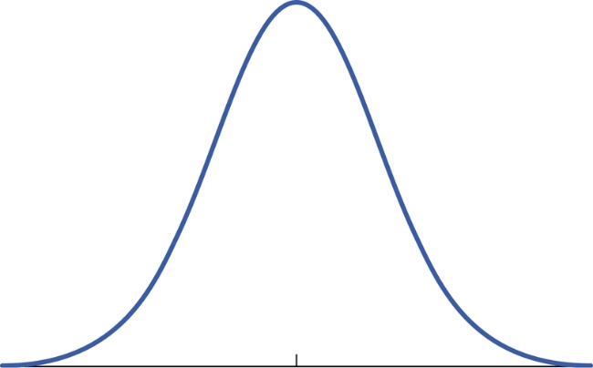
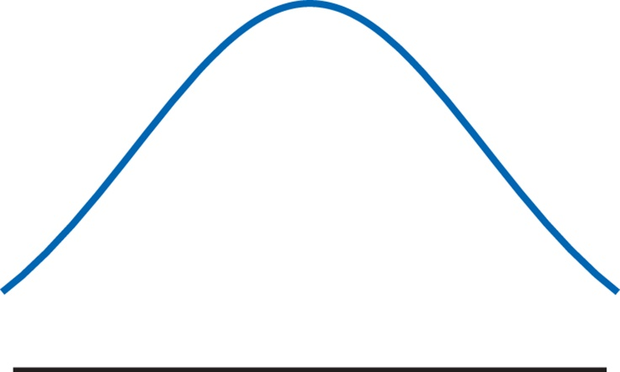
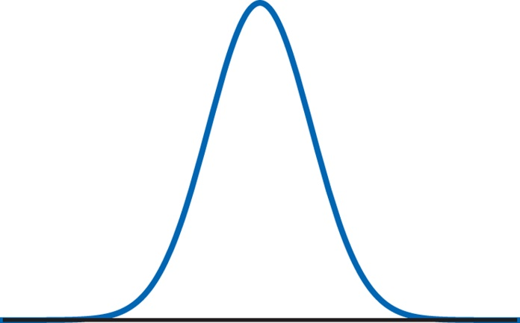
Shapes of Histograms (cont)
Normal distribution
Heavy Tails
Light Tails

Slide 21
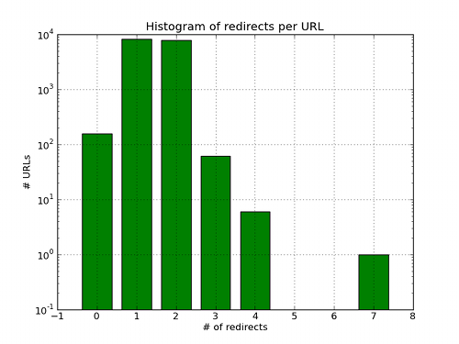
Outliers
http://ewencp.org/blog/url-reshorteners/

